Slide 1
Unit Testing

Slide 2
Course Objectives
At the end of this course, you will be able to:
Define unit testing, its concepts, scope, benefits and limitations.
Explain the implementation of Software Development Lifecycle (SDLC) with Test Driven Development (TDD) methodology.
Explain about the techniques and environment that you need to consider for performing unit testing.
Identify different unit testing framework tools.

Slide 3
Course Map
Testing Framework Tools
Techniques & Environment
Implementation of SDLC with TDD
Introduction to Unit Testing
Topics
Types of testing
Framework tools for various programming language
Framework tools for Java
Framework tools for C# Dotnet
Framework tools for PL/SQL
Junit Demonstration
Topics
Testing Environment
Testing Techniques
Deliverables
Sample Test Case
Topics
Introduction to SDLC
TDD Methodology
Stage Containment
Sample SDLC - V Model
Topics
What is Unit Testing
Purpose and Scope
Unit Testing Concepts
Benefits and Limitations

Slide 4
Topic list
What is Unit Testing
Purpose and Scope
Unit Testing Concepts
Benefits and Limitations

Slide 5
What is Unit Testing?
Definition of Unit
Unit is defined as a smallest component in programming.
In Procedural Programming, a Procedure/Function/Individual program is referred as a Unit.
In Object Oriented Programming, a Module/Class is referred as a Unit.
Definition of Unit Testing
Proactive Approach
Unit testing is a proactive approach, which is performed in the Build stage of Software Development Process.
Identifies error before Testing Phase
Used to identify errors by testing each unit of code before moving to the testing phase in Software Development Process.
Known as Component Testing
It is also called as Component testing.
Performed by Software Developer
Software Developers are responsible to perform the unit testing.

Slide 6
Purpose and Scope
Purpose of Unit Testing
Unit testing is performed to check whether the code is consistent with the detailed design.
It isolates each part of the program, and shows that the individual parts are functioning as expected.
You can perform unit testing to detect bugs in the early phase of SDLC . The cost to fix a bug is less if it is detected early.
Unit testing covers all code, including branches, paths and cycles.
Scope of Unit Testing
In unit testing, the whole program and its modularized functional units are tested.
For newly written code:
For changes made to the existing code:
You need to test all units or components of newly written code.
You need to test all the unit or components that are impacted by the change, along with the changed code.

Slide 7
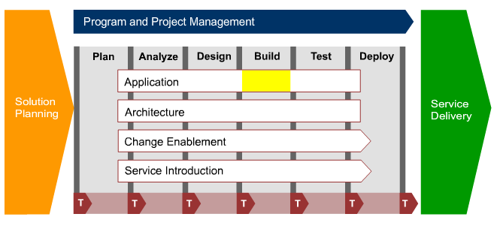
Unit Testing Concepts
Following figure illustrates where the unit testing fits into the Program and Project Management cycle:
Build Phase
Unit Test Case:
Unit Test Case (UTC) is the first step in Build phase, where developer needs to create the Unit Test Cases or Unit Test Script.
Creating Unit Test Cases
Writing the Code
Unit Testing the Code

Slide 8
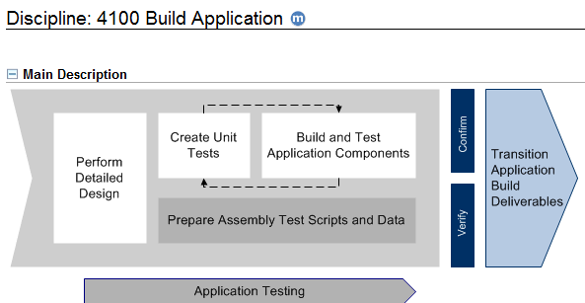
Unit Testing Concepts (Continued)
Following figure illustrates the flow in building an application:
Once test scripts and data are prepared, the developer creates the source code and validates the written code using Unit Testing.
Source code is developed in modules so that units are tested.
An Integrated Development Environment (IDE) is used to carry out Unit testing.
Unit testing makes sure that the client’s requirements are met and identifies and removes the bug.
It also minimizes the risk in the development process as it is performed in the early stages.

Slide 9
Benefits and Limitations
Following tables lists the benefits and limitation of unit testing:
Benefits | Limitations
Following are the key benefits of Unit Testing: Bug-free coding: In the initial phase of development, it finds and removes the defects. Integration simplification: Unit testing eliminates uncertainty. It is used in a bottom-up testing approach. The integration testing becomes easier as parts of a program is tested first, followed by sum of its parts. Living documentation: One can learn the functionality of a unit and its usage at any point of time. The unit testing documentation helps to provide the basic knowledge of the application programming interface. Design for Test Driven Development (TDD): Each unit test is considered as a design entity specifying classes, methods and observable behavior in the program. | Unit testing has many benefits, but it also has few limitations too. Following are the key limitations of Unit Testing: System wide issues are not found: Unable to identify system wide issues and significant test code for combinatorial testing. No guarantee on functionality of system: A functioning of unit/component/class does not guarantee functionality for an entire system. Rigorous effort: Rigorous sense of discipline is required to execute and document the test execution and associated defects. Each input can have a varied range of values. There is often an infinite number of combinations for potential testing. Limited focus: Unit testing is deliberately limited in scope as it focuses on individual components.

Slide 10
Check Your Knowledge
State True or False for the following statement.
“Unit testing is also called Component Testing.”
True
False

Slide 11

Check Your Knowledge
State True or False for the following statement.
“Unit testing is also called Component Testing.”
True
False
Continue
You are right!
Unit testing is also called as Component Testing.

Slide 12
Check Your Knowledge
State True or False for the following statement.
“Unit testing is also called Component Testing.”
True
False
Continue
That’s incorrect!
Unit testing is also called as Component Testing.

Slide 13
Check Your Knowledge
State True or False for the following statement.
“Unit Testing is carried out in an Integrated Development Environment(IDE).”
True
False

Slide 14
Check Your Knowledge
State True or False for the following statement.
“Unit Testing is carried out in an Integrated Development Environment(IDE).”
True
False
Continue
You are right!
Unit Testing is carried out in an Integrated Development Environment(IDE).

Slide 15
Check Your Knowledge
State True or False for the following statement.
“Unit Testing is carried out in an Integrated Development Environment(IDE).”
True
False
Continue
That’s incorrect!
Unit Testing is carried out in an Integrated Development Environment(IDE).

Slide 16
Course Map
Testing Framework Tools
Implementation of SDLC with TDD
Techniques & Environment
Introduction to Unit Testing
Topics
Types of testing
Framework tools for various programming language
Framework tools for Java
Framework tools for C# Dotnet
Framework tools for PL/SQL
Junit Demonstration
Topics
Testing Environment
Testing Techniques
Deliverables
Sample Test Case
Topics
Introduction to SDLC
TDD Methodology
Stage Containment
Sample SDLC - V Model
Topics
What is Unit Testing
Purpose and Scope
Unit Testing Concepts
Benefits and Limitations

Slide 17
Topic list
Introduction to SDLC
TDD Methodology
Stage Containment
Sample SDLC - V Model

Slide 18
Introduction to SDLC
Software Development Lifecycle (SDLC) methodology is a process model for software development that is used in developing and testing software.
SDLC methodology provides a roadmap on:
Development stages in the software lifecycle
Order in which the stages are performed
TDD approach for Unit Testing
SDLC applies Test Driven Development (TDD) approach for testing the code. In this approach you need to create test script and then write the code in accordance with the script. Unit Testing is one of the key task identified within the methodology.

Slide 19
TDD Methodology
TDD Methodology
Other Methodologies
In Test Driven Development (TDD) process, the Unit Test Cases is written before the code development. The developer needs to understand the application specifications and requirements in order to write the tests. Thus TDD approach is a client-focused system.
Use Cases provides a direction regarding the main flow and the exception handling by the application.
Older development methodologies use the approach of writing the code-based on the requirements then writing the Unit, Assembly, Product, and other tests. Unit Test Cases are mostly written after the code is completed.

Slide 20
TDD Methodology (Continued)
In TDD approach, each new feature begins by writing a test script then writing the code to pass the test. The code is then cleaned and refined.
TDD is iterative in nature, in which you need to:
Write a simple test script
Write and run the requirements driven test which should fail since the code for the test is not existing.
Note: If the test passes, either the feature already exists or the test script is written incorrectly to pass.
Write the code to meet the requirement and pass the test.
Code to pass the test
Refactoring
Test first, then code, iterative in smaller increments
Note: Run the test script and fix the code until it passes the tests. You should not write extra code to pass the test.
Perform small changes to the overall body of code to alter the internal structure without changing the external behaviors or the system’s ability to satisfy the functional requirements. Refactoring reduces system complexity, and improves maintainability and readability with efficient architecture.

Slide 21
Stage Containment
Stage Containment is achieved by using V Model and TDD approach where the defects are identified on the same stage where they originate.
Objective of Stage Containment
The goal of stage containment is to:
Identify problems during the development phase before they move to the next stage.
Build quality into the system.
Stage Containment for error identification
The process of determining the origin of a defect is termed root-cause analysis. It highlights the problem or error occurring stages. Root-cause analysis is used to improve the testing process.
Stage Containment helps to fix the process that originally caused the errors or the process that should have prevented them from occurring.
Finding problems from where they originate is important because it becomes expensive and difficult to fix them later. By achieving stage containment the cost for fixing the defect is minimized.

Slide 22
Stage Containment (Continued)
The following figure illustrates the defect-finding pattern of a project without stage containment:
Defect
Origin
Analyze
Design
Detailed Design/Build
Component Test
Assembly Test
Prod Test
Deploy
Defect
Discovered
Analyze
Design
Detailed Design/Build
Component Test
Assembly Test
Prod Test
Deploy
POTENTIAL CHAOS!
This example shows how problems can disrupt the accuracy of project plans, increase costs and make goals difficult to achieve.

Slide 23
Stage Containment (Continued)
The following figure illustrates the defect-finding pattern of a project with stage containment:
Defect
Origin
Analyze
Design
Detailed Design/Build
Component Test
Assembly Test
Prod Test
Deploy
Defect
Discovered
Analyze
Design
Detailed Design/Build
Component Test
Assembly Test
Prod Test
Deploy
Benefits
Cost and effort required for fixing problems is minimized.
Reduces the number of residual problems in the finished solution.
Helps to exhibit defect-finding pattern.
It is easy to use and the progress can be tracked easily.

Slide 24
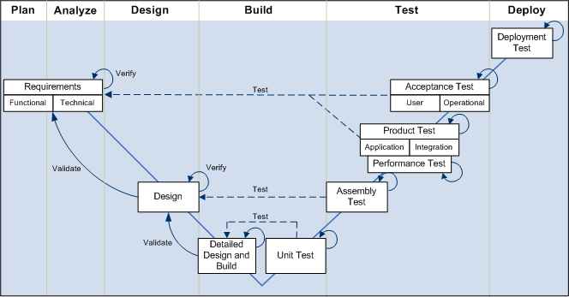
Sample SDLC - V Model
The SDLC methodology can be represented through the V-Model. It is a process model that helps to achieve stage containment through validation activities.
It helps to reduce risk during software development. At various stages of testing, the V-Model verifies and validates the major deliverables.
The project moves through the testing activities once the application is built. It is depicted on the right-hand side of the V
Component Test
Benefit of V Model: It includes validation and verification at each level for stage containment.

Slide 25
Check Your Knowledge
___________ searches for and fixes errors in the same process where they originated from.
Stage Containment
Unit Testing
Assembly Testing
Product Testing

Slide 26
Check Your Knowledge
___________ searches for and fixes errors in the same process where they originated from.
Stage Containment
Unit Testing
Assembly Testing
Product Testing
Continue
You are right!
Stage Containment searches for and fixes errors in the same process where they originated from.

Slide 27
Check Your Knowledge
___________ searches for and fixes errors in the same process where they originated from.
Stage Containment
Unit Testing
Assembly Testing
Product Testing
Continue
That’s incorrect!
Stage Containment searches for and fixes errors in the same process where they originated from.

Slide 28
Check Your Knowledge
State True or False for the following statement.
“Stage containment helps to exhibit defect-finding pattern.”
True
False

Slide 29
Check Your Knowledge
State True or False for the following statement.
“Stage containment helps to exhibit defect-finding pattern.”
True
False
Continue
You are right!
Stage containment helps to exhibit defect finding pattern.

Slide 30
Check Your Knowledge
State True or False for the following statement.
“Stage containment helps to exhibit defect-finding pattern.”
True
False
Continue
That’s incorrect!
Stage containment helps to exhibit defect finding pattern.

Slide 31
Course Map
Testing Framework Tools
Techniques & Environment
Implementation of SDLC with TDD
Introduction to Unit Testing
Topics
Types of testing
Framework tools for various programming language
Framework tools for Java
Framework tools for C# Dotnet
Framework tools for PL/SQL
Junit Demonstration
Topics
Testing Environment
Testing Techniques
Deliverables
Sample Test Case
Topics
Introduction to SDLC
TDD Methodology
Stage Containment
Sample SDLC - V Model
Topics
What is Unit Testing
Purpose and Scope
Unit Testing Concepts
Benefits and Limitations

Slide 32
Topic list
Testing Environment
Testing Techniques
Deliverables
Sample Test Case

Slide 33
Testing Environment
What is Unit Testing Environment?
The test environment should closely resemble the real running environment. This helps to identify any errors or inconsistencies that arises due to differences in the environment.
The development environment is used for unit testing as it is done at an early stage of product development.
The unit test environment should be same as coding environment so that developer is able to perform it.
Different tools are used depending upon the programming language in which developer implements the functionality.
Example
If developer is implementing code using Java, then the environment should be same. Junit is used for doing Unit Testing. It is an IDE environment for Java.

Slide 34
Testing Techniques
The technique followed by the developers to perform unit testing is “White Box” testing.
It helps to understand the internal workings of the modules which are implemented in Build stage.
It is also called as Glass Box testing or Open Box testing.
Unit test should cover the following aspects:
Unit Test
Code units
Branches
Paths
Cycles
Remember: Individual modules are tested so that next stages of testing are easier and less prone to risks

Slide 35
Testing Techniques (Continued)
General Principles for Test Condition
Following are the general principles that you need to consider for deciding the test condition:
Branch Coverage
Condition Coverage
Loop Coverage
Logic Path Coverage
Interface Coverage
Click each principle to know more.

Slide 36
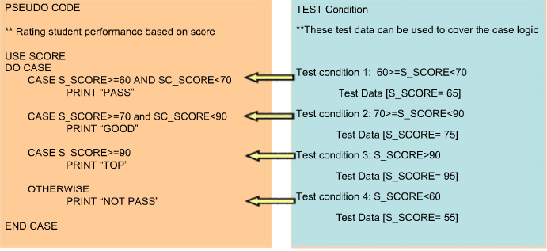
Branch Coverage
Go Back
Any decision point during programming results in branches. During testing, the percentage of branches reached is measured as Branch Coverage.
You need to design test conditions to cover all logical branches in a functional unit so that full branch coverage is reached.
Important: For every condition statement, you need to test both the true and the false branches.
Example of branch coverage:
Some conditions that may belong in this category are:
IF - ELSE - ENDIF statements
CASE - WHEN - ENDCASE statements
WHILE - ENDWHILE condition statements.
Notes:
Additional Information:

Slide 37
Condition Coverage
Go Back
The condition coverage checks both the true and false condition of every sub-condition within an expression. Ensure that every sub-condition is tested at least once. Condition coverage is similar to branch coverage.
Important: Ensure that every possible value of every judgment is executed at least once.
Example: Using the condition “M is greater than or equal to 9”, Based on this condition we can design three test conditions to cover all of the branches.
M equals to 8 covers the ELSE branch – it will give ERROR.
M equals to 9 covers if branch and it will be SUCCESS.
M equals 10 covers If branch, it will be SUCCESS.
Some conditions that may belong in this category are:
Boundary conditions (Conditions that allow ranges)
IF-ELSE conditions and its combinations belong in this category.
Code | Test Coverage Conditions
IF M>=9 PERFORM 10100_SUCCESS ELSE PERFORM 10200_ERROR ENDIF | M = 8 M = 9 M = 10

Slide 38
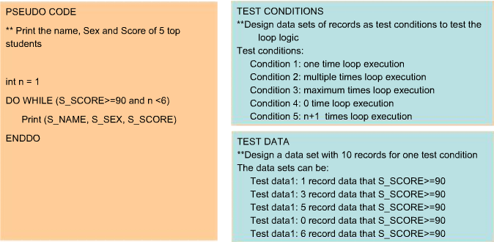
Loop Coverage
Go Back
Loop provides a mechanism for repeating a block of code for a fixed number of times or for iterating through a set of values.
Loop coverage techniques determine the percentage of the source code entering a loop and cycled completely.
Important:
Test conditions should be developed to cover all possible:
Looping cycles such as; loop executed once, or multiple times, or executed maximum times, or even the loop never being executed.
Outputs and break conditions based on the loop execution.
Example of loop coverage:
Some conditions that may belong in this category are loop statements such as:
FOR
WHILE
DO-WHILE

Slide 39
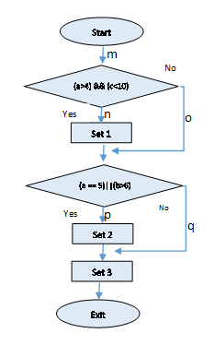
Logic Path Coverage
Go Back
Logic Path Coverage is an important criteria in unit testing where you need to test the logical path of the current program unit. When designing test conditions, you need to list all the paths based on which you should identify the test data that needs to be used.
Example: You can find four paths in the flowchart. They are mnp, mop, moq, and mnq. To cover all of these paths, you need to design 4 sets of test data as shown:
Test Conditions
Test Paths | Test Conditions
mnp mop moq mnq | a=5 b=7 c=6 a=5 b=6 c=16 a=3 b=7 c=16 a=6 b=6 c=6
Note: If the identified logical path is long, then divide the long path into multiple short paths so that the number of tests gets reduced.

Slide 40
Interface Coverage
Go Back
Interface testing is the basis for assembly test and it is under the scope of unit test. Interface testing ensures that the interface of the each program unit and the integrated bigger module works as expected. Other tests are meaningful only if data can flow throughout the modules correctly.
The factors to be considered while testing the Interface are:
Ensure that the interface of each program unit works correctly.
Maintain consistency of global variable (real and formal) definitions in all the modules.
Pay attention to the reference parameters.
Maintain the sequence of parameters in all the modules.

Slide 41
Deliverables
Deliverable is the documented information and knowledge produced as the result of a methodology process.
Following are the key importance of completing the deliverables:
Provides documentation.
Flags completion of each phase.
Ensures traceability.
Ensures quality in the tasks performed.
Aids in analysis of issues/defects.
Ensures the adherence to processes and standards.
Aids in Project Management.

Slide 42
Deliverables (Continued)
Following are the deliverables of unit testing:
Test Conditions and Expected Results
Test Cycle Control Sheet
Test Data
Test Drivers/Media Programs Document
Test Environment Document
Note:
All the above deliverables are created by the Detailed Designer.
These documents contain the expected result with valid test data.
While executing the test script, it compares the actual result with the documented data and provides necessary comments.

Slide 43
Sample Test Case
Scenario
Rohit is working as a developer in Accenture Demo project. He has analyzed the requirements and developed a login page of the application. He is required to create a test case for the login page.
The test case template that Rohit needs to use for the login page is:
Test Case ID | Test Case Name | Description | Expected Result | Input Data | Actual Result | Pass/Fail | Comments
Test Condition Expected Result (TCER)
Following table represents the test condition and expected result for the scenario:
Test Case ID | Test Case Name | Description | Expected Result | Input Data | Actual Result | Pass/ | Comments
 |  |  |  |  |  | Fail
TC 1.0 | Login | Type the following URL: | Login page is displayed | https://email.accenture.com | Login page was displayed | Pass
 |  | https://email.accenture.com
TC 2.0 | Username | Check whether the username field is present | Username field is present |  | Username field was present | Pass
TC 2.1 | Username | Input the Valid data | Username is displayed | rohit.r@accenture.com | Username was displayed | Pass
TC 2.2 | Password | Check whether the password field is present | Password field is present |  | Password field is present | Pass
TC 2.3 | Password | Input the Valid data | Password is displayed as ***** | ***** | Password is displayed as ***** | Pass

Slide 44
Check Your Knowledge
Which technique is followed by the developer to perform unit testing?
Static testing
Automated testing
Red Box testing
White Box testing

Slide 45
Check Your Knowledge
Which technique is followed by the developer to perform unit testing?
Static testing
Automated testing
Red Box testing
White Box testing
Continue
You are right!
White Box testing is followed by the developer to perform unit testing.

Slide 46
Check Your Knowledge
Which technique is followed by the developer to perform unit testing?
Static testing
Automated testing
Red Box testing
White Box testing
Continue
That’s incorrect!
White Box testing is followed by the developer to perform unit testing.

Slide 47
Check Your Knowledge
Which technique in unit testing checks both the true and false condition of every sub-condition within an expression?
Logic Path
Condition
Loop
Branch

Slide 48
Check Your Knowledge
Which technique in unit testing checks both the true and false condition of every sub-condition within an expression?
Logic Path
Condition
Loop
Branch
Continue
You are right!
Condition coverage is the technique.

Slide 49
Check Your Knowledge
Which technique in unit testing checks both the true and false condition of every sub-condition within an expression?
Logic Path
Condition
Loop
Branch
Continue
That’s incorrect!
Condition coverage is the technique.

Slide 50
Course Map
Testing Framework Tools
Techniques & Environment
Implementation of SDLC with TDD
Introduction to Unit Testing
Topics
Types of testing
Framework tools for various programming language
Framework tools for Java
Framework tools for C# Dotnet
Framework tools for PL/SQL
Junit Demonstration
Topics
Testing Environment
Testing Techniques
Deliverables
Sample Test Case
Topics
Introduction to SDLC
TDD Methodology
Stage Containment
Sample SDLC - V Model
Topics
What is Unit Testing
Purpose and Scope
Unit Testing Concepts
Benefits and Limitations

Slide 51
Topic list
Types of testing
Framework tools for various languages
Framework tools for Java
Framework tools for C# Dotnet
Framework tools for PL/SQL
Junit Demonstration

Slide 52
Types of testing
Following are the different type of testing:
Manual Testing
Manual Testing
Manual testing is the process of software testing where the software is tested manually for its defects.
Testers will play the role of end user and test the application.
Manual testing is the process of software testing where the software is tested manually for its defects.
Testers will play the role of end users and tests the application.
Automated Testing
Automated testing
Automation testing is another way of testing the software where the different automation testing tools are used.
Testers generate test scripts for different functionalities of an application using automation tools.
Knowledge on automation tool is required to perform automation testing.
Automation testing is another way of testing the software using different automation testing tools for different types of testing.
Testers generate test scripts for different functionalities of an application using automation tools.
Knowledge on automation tool is required to perform automation testing.

Slide 53
Types of testing (Continued)
Following are the different type of testing:
Static Testing
Static Testing is a form of testing where the software is actually not used.
It can also be called as Dry Run Testing.
Syntax checking and manually reading the code to find errors are the methods followed in static testing. This type of testing is performed by developers before compiling the code.
Dynamic Testing
Dynamic Testing uses the software, where you need to provide input values, and check whether the output is as expected.
Dynamic Testing can take place only after compilation.

Slide 54
Frameworks for Various Languages
Following table lists the unit testing framework tools for various programming languages:
Programming Language | Unit Testing Frameworks
1. ABAP | ABAP Unit
2. Ada | AUnit
3. .Net | Nunit
4. Java | Junit
5. Haskell | Hunit
6. PegaRULES Process Commander | PRUnit
7. PHP | PHPUnit
8. Smalltalk | Sunit
9. PL/SQL | PLUTO,pl/unit
10. VisualBasic (VB6.0) | vbUnit

Slide 55
Framework Tools for Java
You need to install JDK (Java Development Kit), which comes with the JVM (Java Virtual Machine) and JRE(Java Runtime Environment) to use the facility of unit testing in Java.
Only after installing JDK you can compile, run and test the code.
You can also install IDE (Integrated Development Environment), such as Eclipse / NetBeans.
Testing tools for Java
Following are the testing tools for Java:
Arquillian
Jtest
The Grinder
TestNG
Junit
Jwalk
Mockito
Powermock
Notes:
For more information about these tools
Ref: https://blog.idrsolutions.com/2015/02/8-useful-java-testing-tools-frameworks-programmers-developers-coders/
Testing tools for Java
Here are my top ‘8 tools to help you with Java testing (& Frameworks)’.
1. Arquillian
Arquillian is a highly innovative and extendible testing platform for JVM that allows developers to easily create automated integration, functional and acceptance tests for Java. Arquillian allows you to run test in the run-time so you don’t have to manage the run-time from the test (or the build). Arquillian can be used to manage the life cycle of the container (or containers),bundling test cases, dependent classes and resources. It is also capable of deploying archive into containers and execute tests in the containers and capture results and create reports.
Arquillian integrates with familiar testing frameworks such as JUnit 4, TestNG 5 and allows tests to be launched using existing IDE, and because of its modular design it is capable of running Ant and Maven test plugins. You can find out more on their website.
2. JTest
JTest also known as ‘Parasoft JTest’ is an automated Java software testing and static analysis software made by Parasoft. JTest includes functionality for Unit test-case generation and execution, static code analysis, data flow static analysis, and metrics analysis, regression testing, run-time error detection.
There are also features that allow you to peer code review process automation and run-time error detection for e.g.: Race conditions, exceptions, resource and memory leaks, security attack vulnerabilities. You can find out more on their website.
3. The Grinder
‘The Grinder’ is a Java load testing framework that was designed to make sure it was easy to run and distributed test’s using many load injector machines. The Grinder can Load test on anything that has a Java API. This includes HTTP web servers, SOAP and REST web services, and application servers and including custom protocols and the test scripts are written in the powerful Jython and Clojure languages. The GUI console for The Grinder allows you to have multiple load injectors to be monitored and controlled and Automatic management of client connections and cookies, SSL, Proxy aware and Connection throttling. You can find more in depth information on The Grinders features here.
It is freely available under a BSD-style open-source license. You can find out more on their website.
4. TestNG
TestNG is a testing framework designed for the Java programming language and inspired by JUnit and NUnit. TestNG was primarily designed to cover a wider range of test categories such as unit, functional, end-to-end, integration, etc. It also introduced some new functionality that make it more powerful and easier to use, such as: Annotations, Running tests in big thread pools with various policies available, code testing in a multi thread safe, flexible test configurations, data-driven testing support for parameters, and more.
TestNG is supported by a variety of tools and plug-ins such as Eclipse, IDEA, Maven, etc and You can find out more on their website.
5. JUnit
JUnit is a unit testing framework designed for the Java programming language. JUnit has played an important role in the development of test-driven development frameworks. It is one of a family of unit testing frameworks which is collectively known as the xUnit that originated with SUnit.
JUnit is linked as a JAR at compile-time and can be used to write repeatable tests
You can find out more about JUnit on their website.
6. JWalk
JWalk is designed as a unit testing toolkit for the Java programming language. It has been designed to support a testing paradigm called Lazy Systematic Unit Testing. The JWalkTester tool performs any tests of any compiled Java class, supplied by a programmer. It is capable of testing conformance to a lazy specification, by static and dynamic analysis, and from hints by the programmer behind the code.
You can find out more about JWalk on their website.
7. Mockito
Mockito is designed as a open source testing framework for Java which is available under a MIT License. Mockito allows programmers to create and test double objects (mock objects) in automated unit tests for the purpose of Test-driven Development (TDD) or Behavior Driven Development (BDD).
You can find out more about Mockito on their website.
8. Powermock
PowerMock is a Java Framework for unit testing of source code and It runs as an extension of other Mocking frameworks like Mockito or EasyMock but comes with more powerful capabilities. PowerMock utilizes a custom classloader and bytecode manipulator to enable mocking of static methods, removal of static initializes, constructors, final classes and methods and private methods. It as been primarily designed to extend the existing API’s with a small number of methods and annotations to enable the extra features.
It is available under an open source Apache License 2.0 and is available in Powermock Google Code site.

Slide 56
Framework Tools for C# DotNet
Nunit is a testing framework tool used for all Dotnet languages. It is initially ported from Junit and added with many new features in production release version 3.0.
Features of Nunit
Following are the key features of Nunit:
Nunit is a popular testing framework and created by Philip Craig for dotnet.
It is a unit testing for performing the Unit Testing on Dotnet platform.
It is an automated Unit testing tool.
It is an open source.
Test scripts should be created by the developer and that can be executed in this.
Testing tools for DotNet
Following are the testing tools for DotNet:
DbUnit.Net
MSTest
csUnit
NUnitAsp
Pex
Notes:
For more information about these tools
Ref: http://www.nunit.org/
Ref: https://en.wikipedia.org/wiki/List_of_unit_testing_frameworks#.NET_programming_languages
License
NUnit is Open Source software and NUnit 3.0 is released under the MIT license. . Earlier releases used the NUnit license Both of these licenses allow the use of NUnit in free and commercial applications and libraries without restrictions.
About Us
NUnit 3.0 was created by Charlie Poole, Rob Prouse, Simone Busoli, Neil Colvin and numerous community contributors.
Earlier versions of NUnit were developed by Charlie Poole, James W. Newkirk, Alexei A. Vorontsov, Michael C. Two and Philip A. Craig.
For more information about these tools
http://www.codeproject.com/Articles/178635/Unit-Testing-Using-NUnit
NUnit is a unit testing framework for performing unit testing based on the .NET platform. It is a widely used tool for unit testing and is preferred by many developers today. NUnit is free to use. NUnit does not create any test scripts by itself. You have to write test scripts by yourself, but NUnit allows you to use its tools and classes to make unit testing easier. The points to be remembered about NUnit are listed below:
NUnit is not an automated GUI testing tool.
It is not a scripting language, all tests are written in .NET supported languages, e.g., C#, VC, VB.NET, J#, etc.
NUnit is a derivative of the popular testing framework used by eXtreme Programming (XP). It was created by Philip Craig for .NET. It is also available in the name of jUnit for Java code testing.
NUnit works by providing a class framework and a test runner application. They can be downloaded from here. The class framework allows to write test cases based on the application. The test is run using the test runner application downloaded from the above link.

Slide 57
Framework Tools for PL/SQL
Following are the different unit testing framework tools for PL/SQL:
utPLSQL
PL/SQL Unit Testing for Oracle (PLUTO)
SQL Developer
Pl/unit
It is an open source testing tool, that was developed by Steven Feuerste.
It is an open source testing tool which is modelled after Junit. It is based on the Oracle PL/SQL Object system.
IDE environment for SQL and PL/SQL. It includes a unit tester as a part of it.
It is a unit testing tool which provides the functionality to create the unit tests which is developed using Pl/SQL code.
Notes:
For more information about these tools
Ref: https://en.wikipedia.org/wiki/List_of_unit_testing_frameworks#PL.2FSQL

Slide 58
Junit Demo
The JUnit is a open source testing framework. Junit provides a stable testing environment and a robust set of features and tools to perform testing.
In this demonstration, you can learn how to perform Component (Unit) testing in the Java IDE environment.
To view the details steps on using Junit demonstration, click the View button:
View Steps
To view the Junit demonstration, click the attached video:

Slide 59

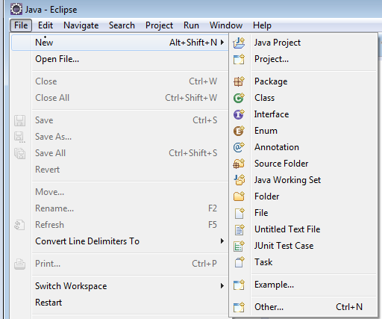
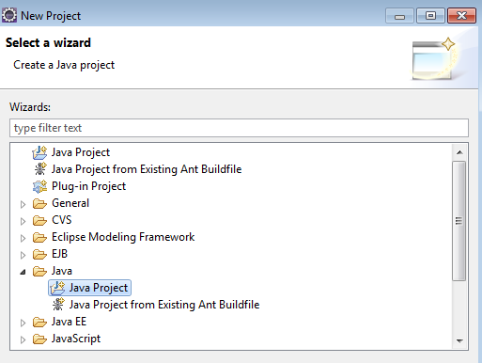
Junit Demo
Go Back
The demo steps to perform unit testing using Junit:
1) Start Java IDE Environment: Eclipse
2) Open File → New → Project → Java Project.
Notes:
Additional Information:
The JUnit open source testing framework provides both a stable testing environment and a robust set of testing features and tools.
JUnit assertions exist as methods supporting the assertion concepts covered in the earlier course modules.
Text fixtures provide a known state from which to begin test execution. Test fixtures ensure repeatable test results.
Test suites are collections of tests executed to test software programs demonstrating the code conforms to expected behaviors and to uncover code defects.
Test runners provide an easy test execution tool with visual confirmation of test success and failure.
In summary, JUnit is a JAR (Java Archive) library that provides the features needed to create, execute, and check the results of automated test cases written in Java.

Slide 60
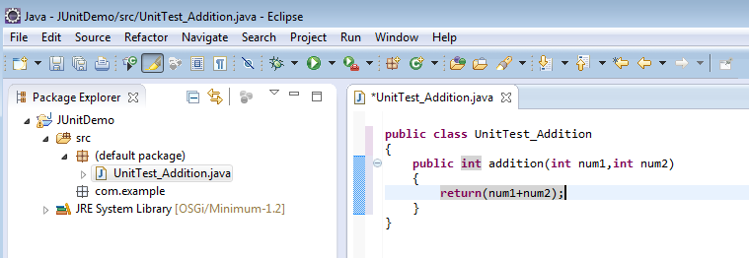
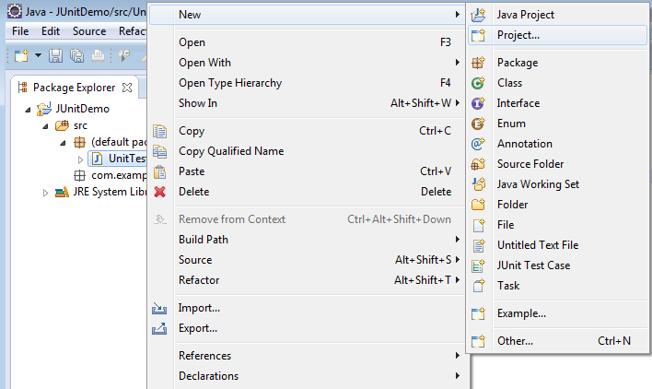
Junit Demo (Continued)
Go Back
3) Create a Package .com.
4) Create a Class without Main function—AdditionDemo Code.
public class AdditionDemo
{
public int add(int num1,int num2)
{
return num1+num2;
}
}
5) Create a new Junit Test Case.

Slide 61
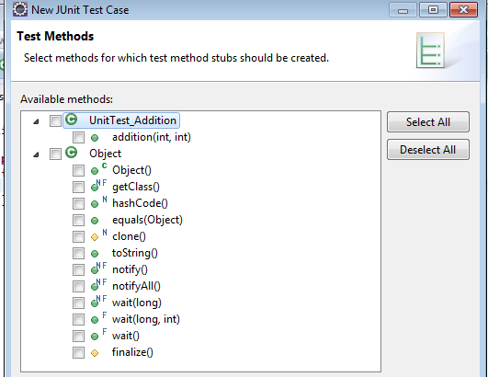
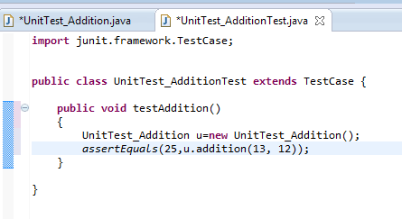
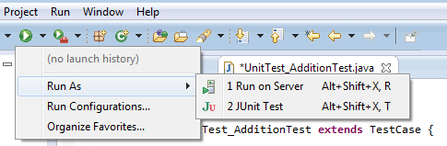
Junit Demo (Continued)
Go Back
6) Select the method to use.
7) Add the Assert method, the following code.
8) Run as Junit Test.
assertEquals(25, u.addition(13,12));

Slide 62
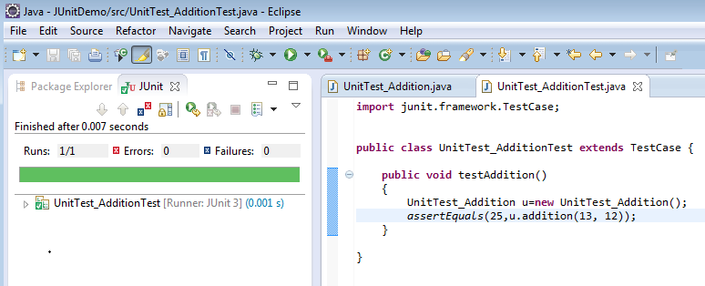
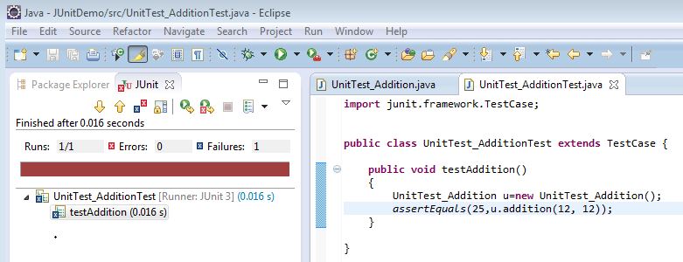
Junit Demo (Continued)
Go Back
9) When the test is executed successfully you are able to see green color bar. Expected result matches with the actual result.
Assert method:
assertEquals(25,a.add(13, 12));
25 is the expected output by adding 13 and 12(num1=13, num2=12)
It is Test Pass.
10) When expected result wont match with the actual result then it shows the red color bar.
Assert method:
assertEquals(25,a.add(12, 12));
25 is the expected output by adding 12 and 12(num1=12, num2=12)
It is an Failure Test.

Slide 63
Check Your Knowledge
In which type of testing, the methods like syntax checking and manual reading of the code are performed?
Static testing
Automated testing
Dynamic testing
Manual testing

Slide 64
Check Your Knowledge
In which type of testing, the methods like syntax checking and manual reading of the code are performed?
Static testing
Automated testing
Dynamic testing
Manual testing
Continue
You are right!
In Static testing, the methods like syntax checking and manual reading of the code are performed.

Slide 65
Check Your Knowledge
In which type of testing, the methods like syntax checking and manual reading of the code are performed?
Static testing
Automated testing
Dynamic testing
Manual testing
Continue
That’s incorrect!
In Static testing, the methods like syntax checking and manual reading of the code are performed.

Slide 66
Check Your Knowledge
_________ is used to efficiently execute test scripts with less human intervention.
Static testing
Automated testing
Dynamic testing
Manual testing

Slide 67
Check Your Knowledge
_________ is used to efficiently execute test scripts with less human intervention.
Static testing
Automated testing
Dynamic testing
Manual testing
Continue
You are right!
Automated testing is used to execute scripts with less human intervention.

Slide 68
Check Your Knowledge
_________ is used to efficiently execute test scripts with less human intervention.
Static testing
Automated testing
Dynamic testing
Manual testing
Continue
That’s incorrect!
Automated testing is used to execute scripts with less human intervention.

Slide 69
Course Summary
At the end of this course, you will be able to:
Define unit testing, its concepts, scope, benefits and limitations.
Explain the implementation of Software Development Lifecycle (SDLC) with Test Driven Development (TDD) methodology.
Explain about the techniques and environment that you need to consider for performing unit testing.
Identify different unit testing framework tools.

Slide 70
Reference
https://en.wikipedia.org/wiki/List_of_unit_testing_frameworks
http://www.tutorialspoint.com/junit/
http://www.javatpoint.com/junit-tutorial
ADM Links:
https://m.methodology.accenture.com/core_custom/meth.customv5/tasks/Create%20Unit%20Tests_49C2FF67.html
https://m.methodology.accenture.com/core_pkg/meth.pkg_core/tasks/Build%20and%20Test%20RICEFW%20Components_332BB165.html

Slide 71
Thank You

